Slide 1

AI and Machine Learning Intro
Sayed A. Omar

Slide 2
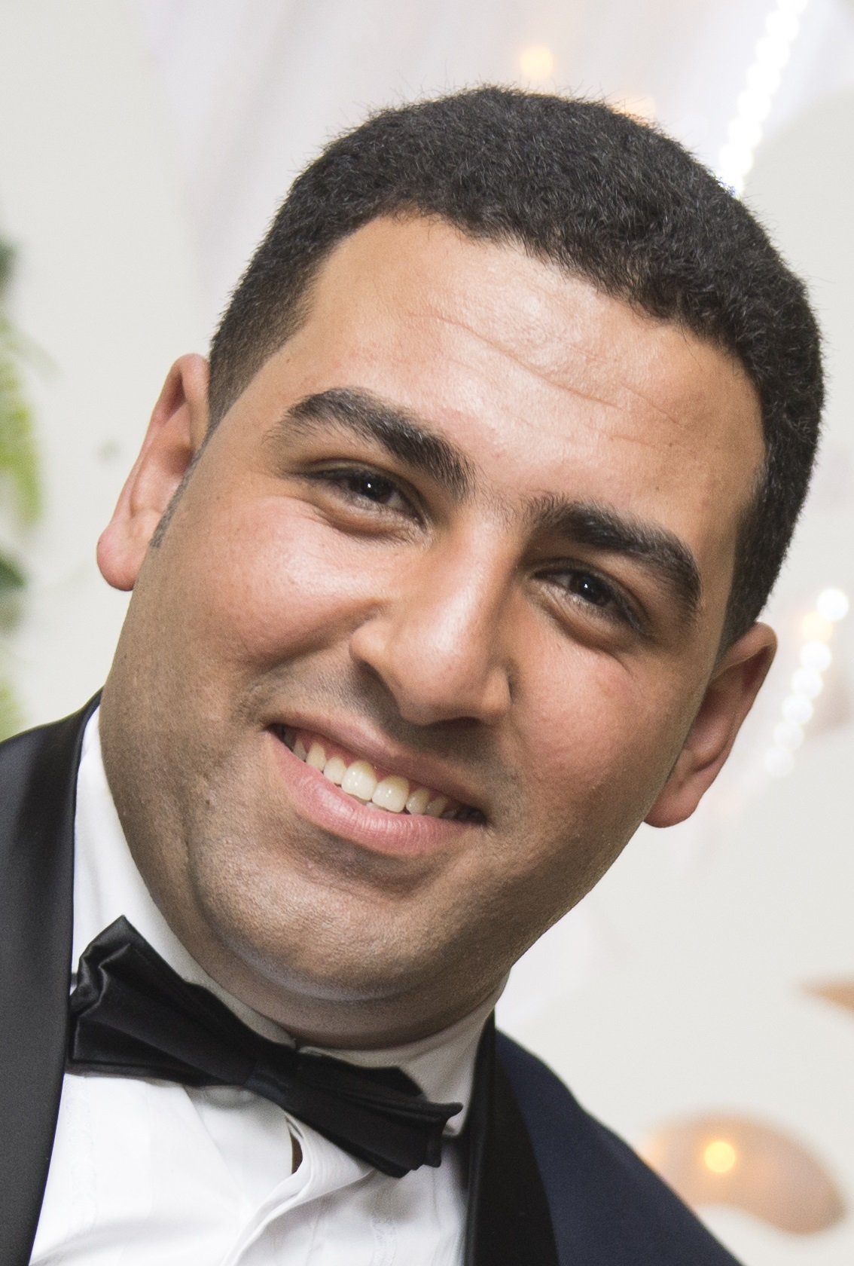
Sayed A. Omar
Sayed is a Machine Learning Engineer, he holds a Bachelor degree in the field of Physics and Computer Science from faculty of science Minia University. Then he joined a master degree program at Cairo University in field of Machine Learning and Artificial Intelligence.
He worked for Orange then he moved to Speakol as Machine Learning Engineer, then he now works for Analytics Patrols as Machine Learning Engineer.
He is always looking forward to help decision makers to achieve them goals clearly depends on insights gained from the data.

Slide 3
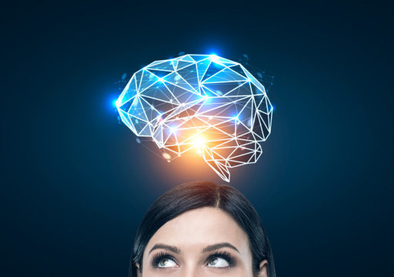
What is Human Intelligence

Slide 4
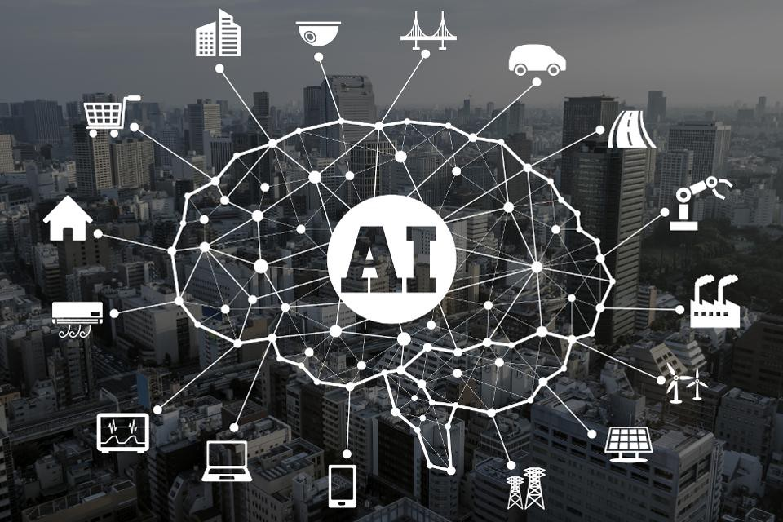
What is Artificial Intelligence?

Slide 5
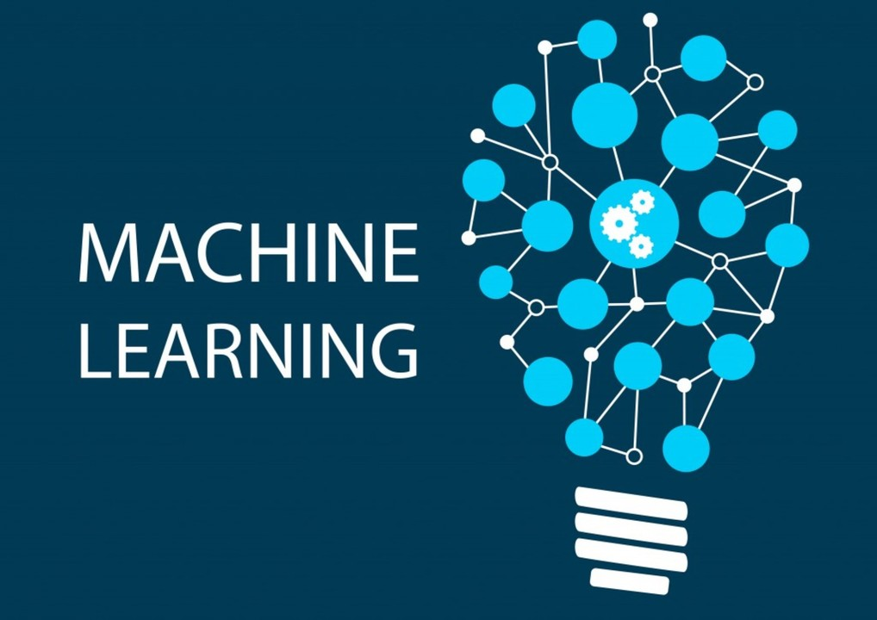
History of Machine Learning
Artificial intelligence are not novelty innovations. In 1943, neurophysiologist Warren McCulloch and mathematician Walter Pitts wrote a paper on how neurons might work. In order to describe how neurons in the brain might work, they modeled a simple neural network using electrical circuits.
Machine Learning on 1959, Arthur Samuel defined the concept of machine learning as the ability of computers to learn to function in ways that they were not specifically programmed to do.
Of course, the timeline from definition to implementation in everyday life can be a long one.

Slide 6
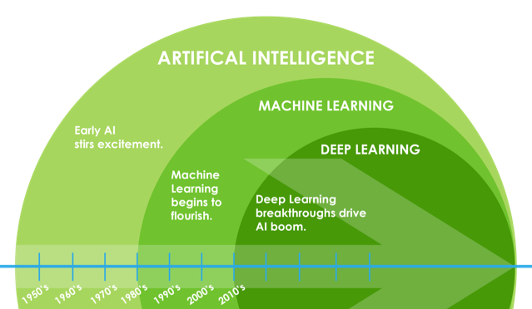
AI Vs. ML Vs. DL

Slide 7

Data Science Or Machine Learning?

Slide 8
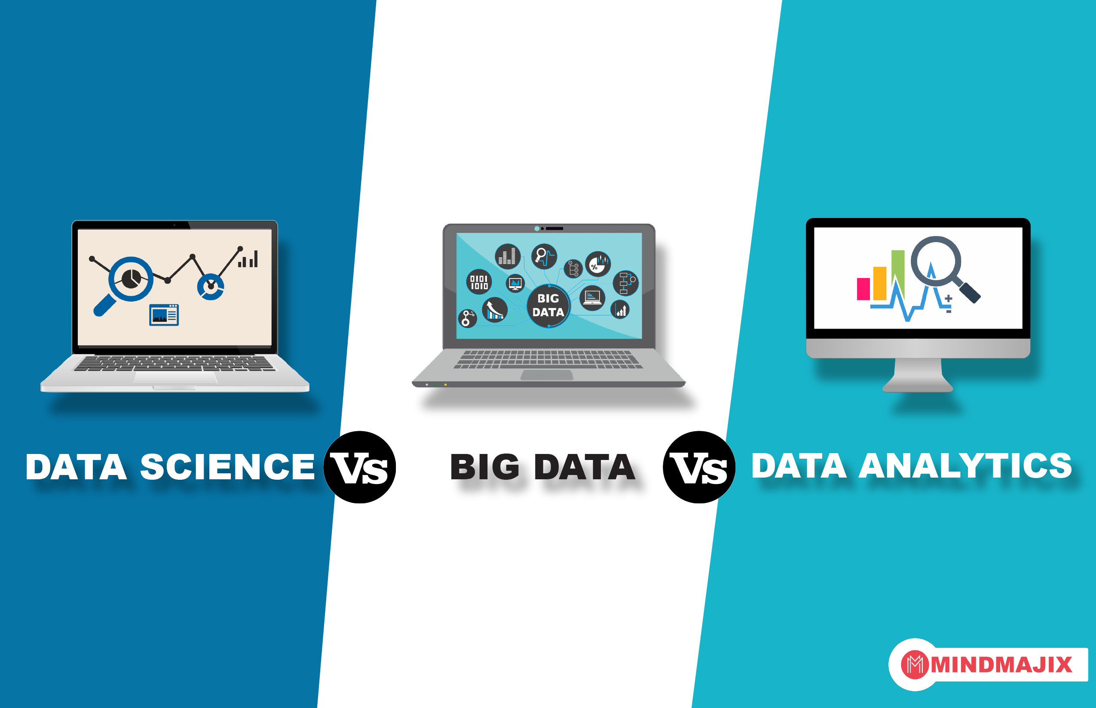
Data Science Vs. Big Data

Slide 9

Game of the day
Notes:
https://ar.akinator.com/

Slide 10
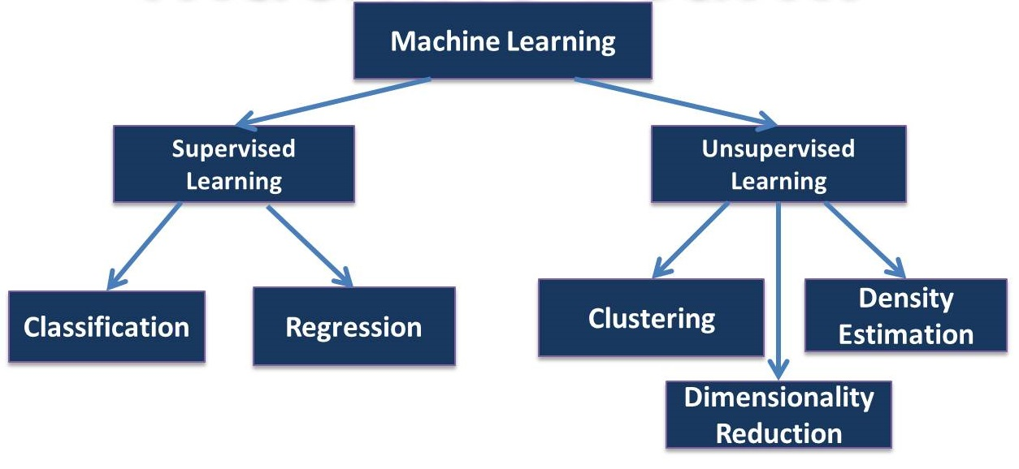
Types of Machine Learning Problems

Slide 11
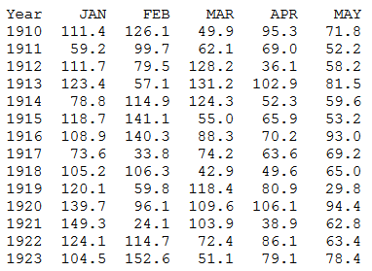
Data set

Slide 12
Applications of Machine Learning

Slide 13
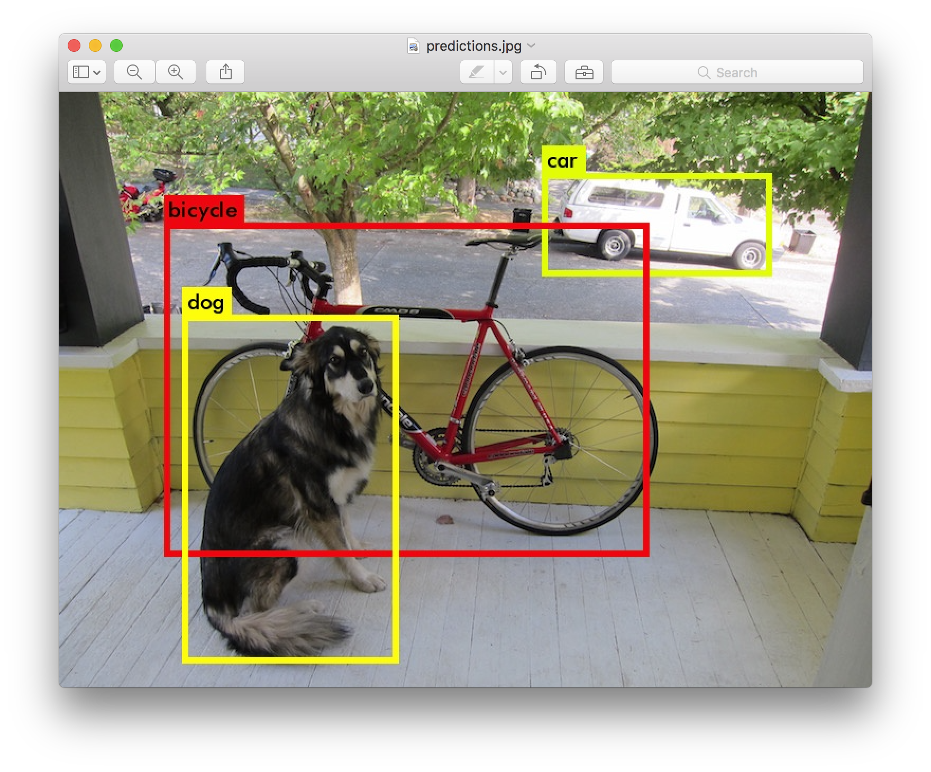
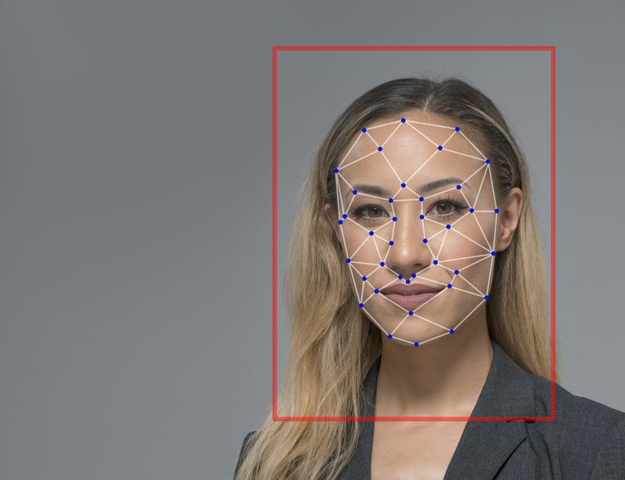
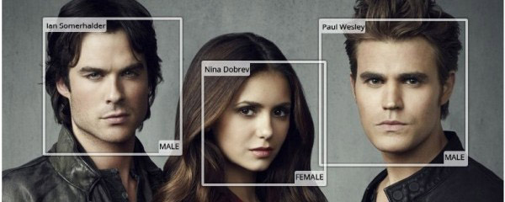
Computer Vision Applications
Notes:
Object Detection
Face recognition
Face Connection
Self driving Car https://www.youtube.com/watch?v=TsaES--OTzM
Sketch 2 Code https://sketch2code.azurewebsites.net

Slide 14
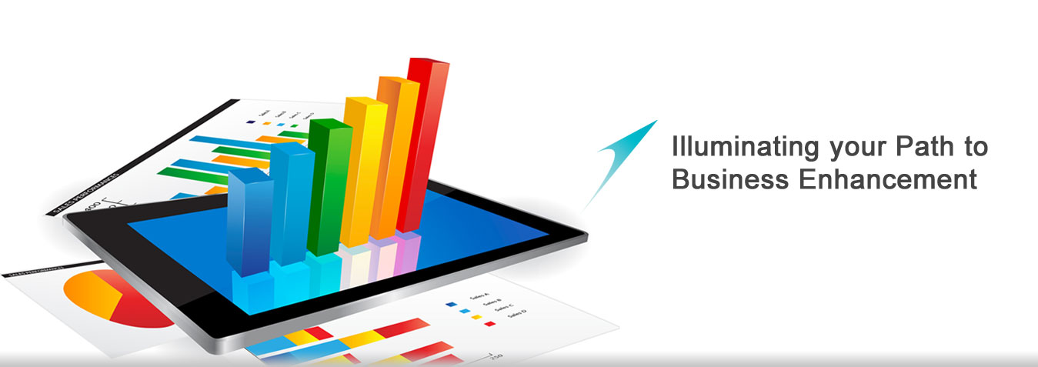
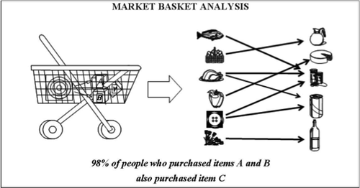
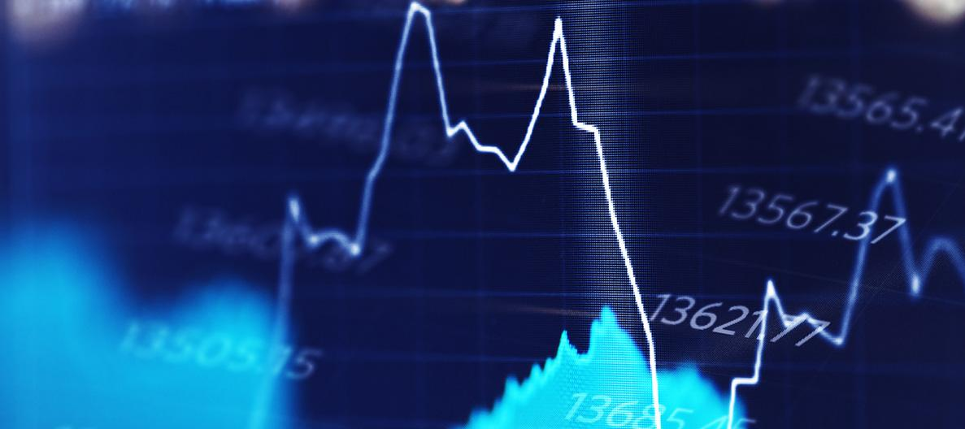
Economics Applications
Notes:
Market Analytics
Stock Market Analytics
Association Rule

Slide 15
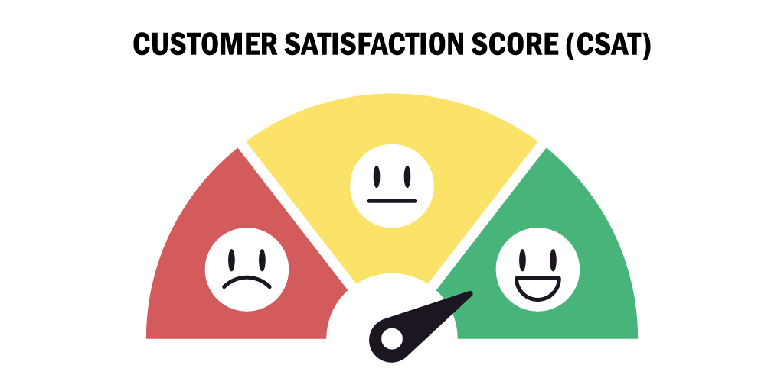

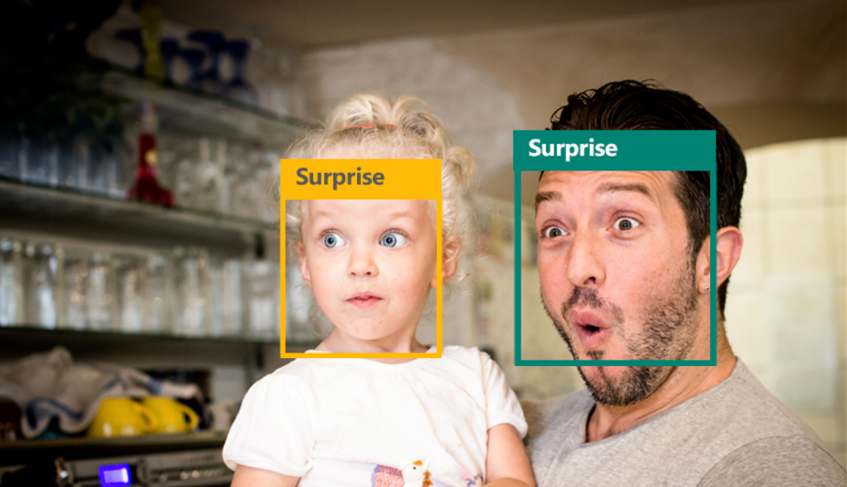
Sentiment Analysis Applications
Notes:
Customer Satisfaction
Psychological treatment
Emotion Detection

Slide 16








Recommendation Sys. Applications
Notes:
Video
Friends and pages
Products
Articles

Slide 17
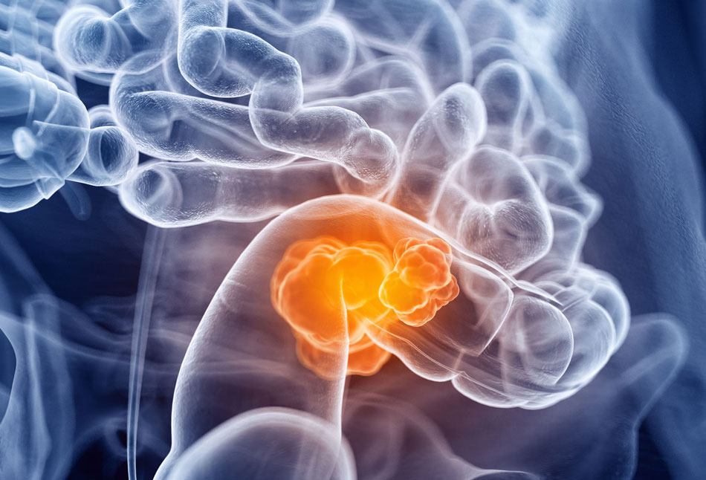
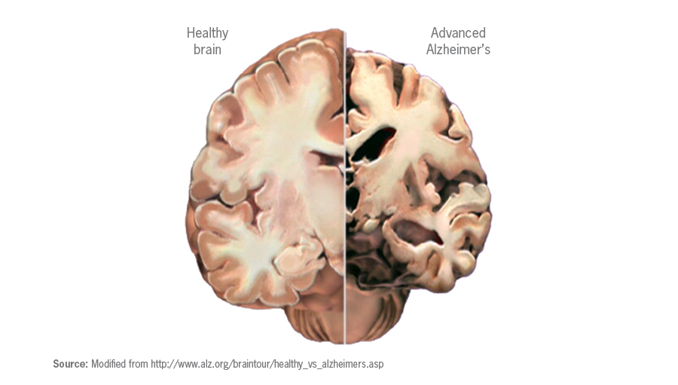

Medical Diagnosis Applications
Notes:
Cancer Detection
Alzheimer Detection
Heart attack detection

Slide 18
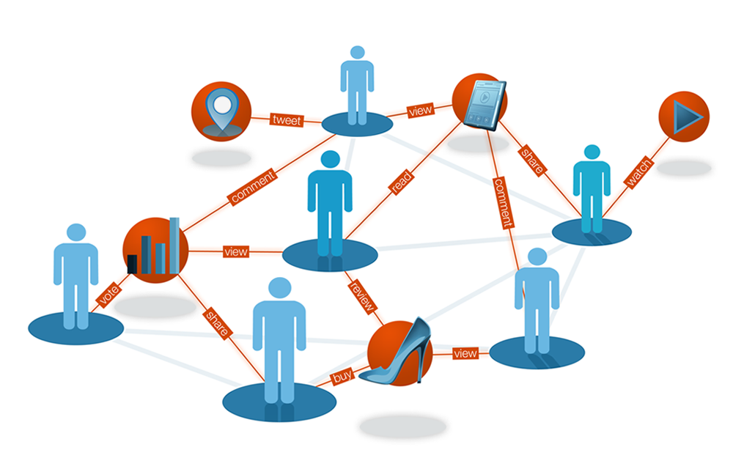

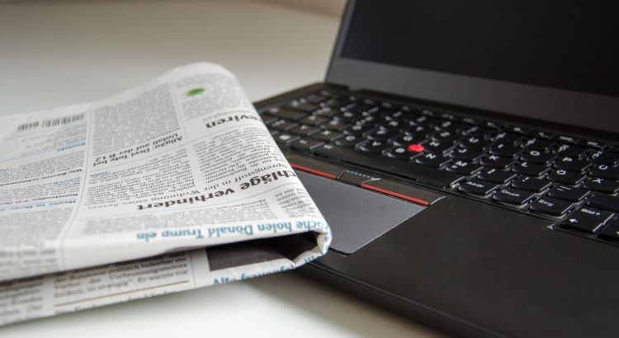
Online Advertising Platforms
Notes:
User behavior analysis
Campaign optimization
Publisher Revenue Optimization

Slide 19
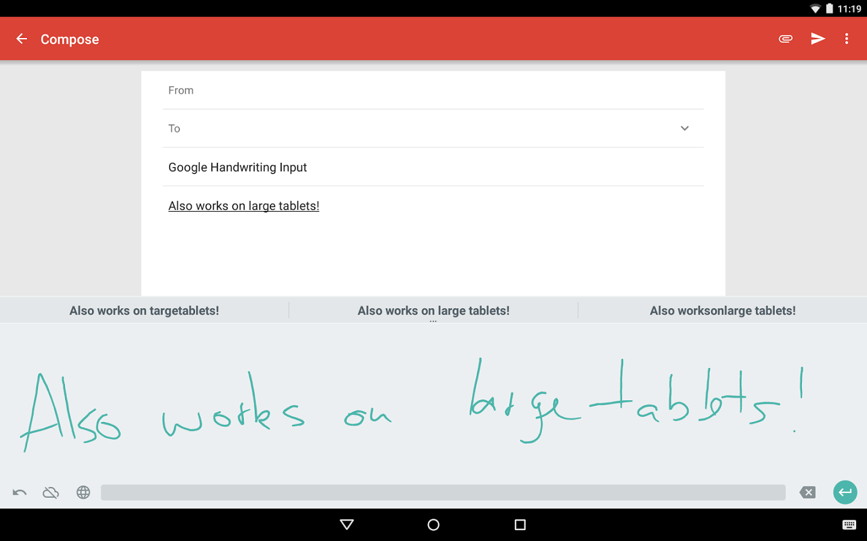
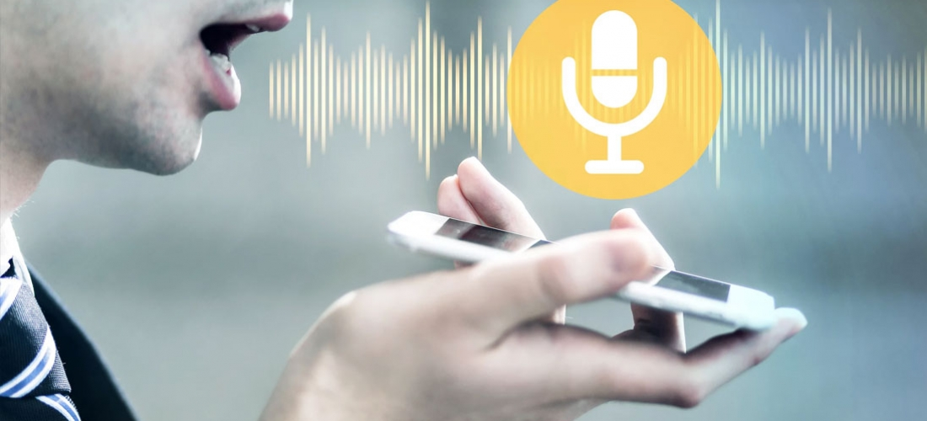
Speech & Hand Writing Recognition

Slide 20
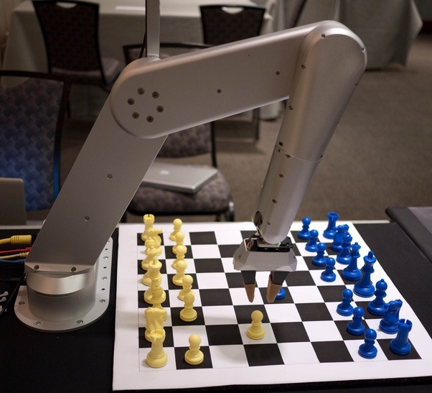
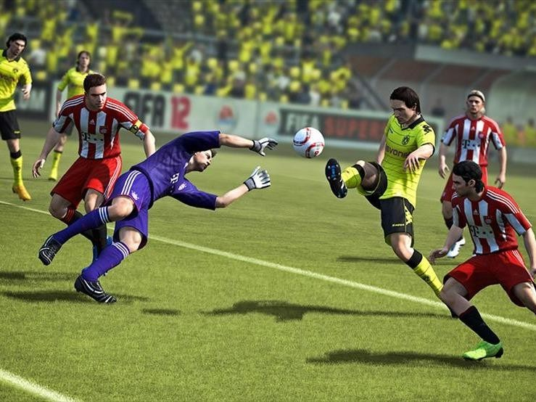
Playing Game

Slide 21
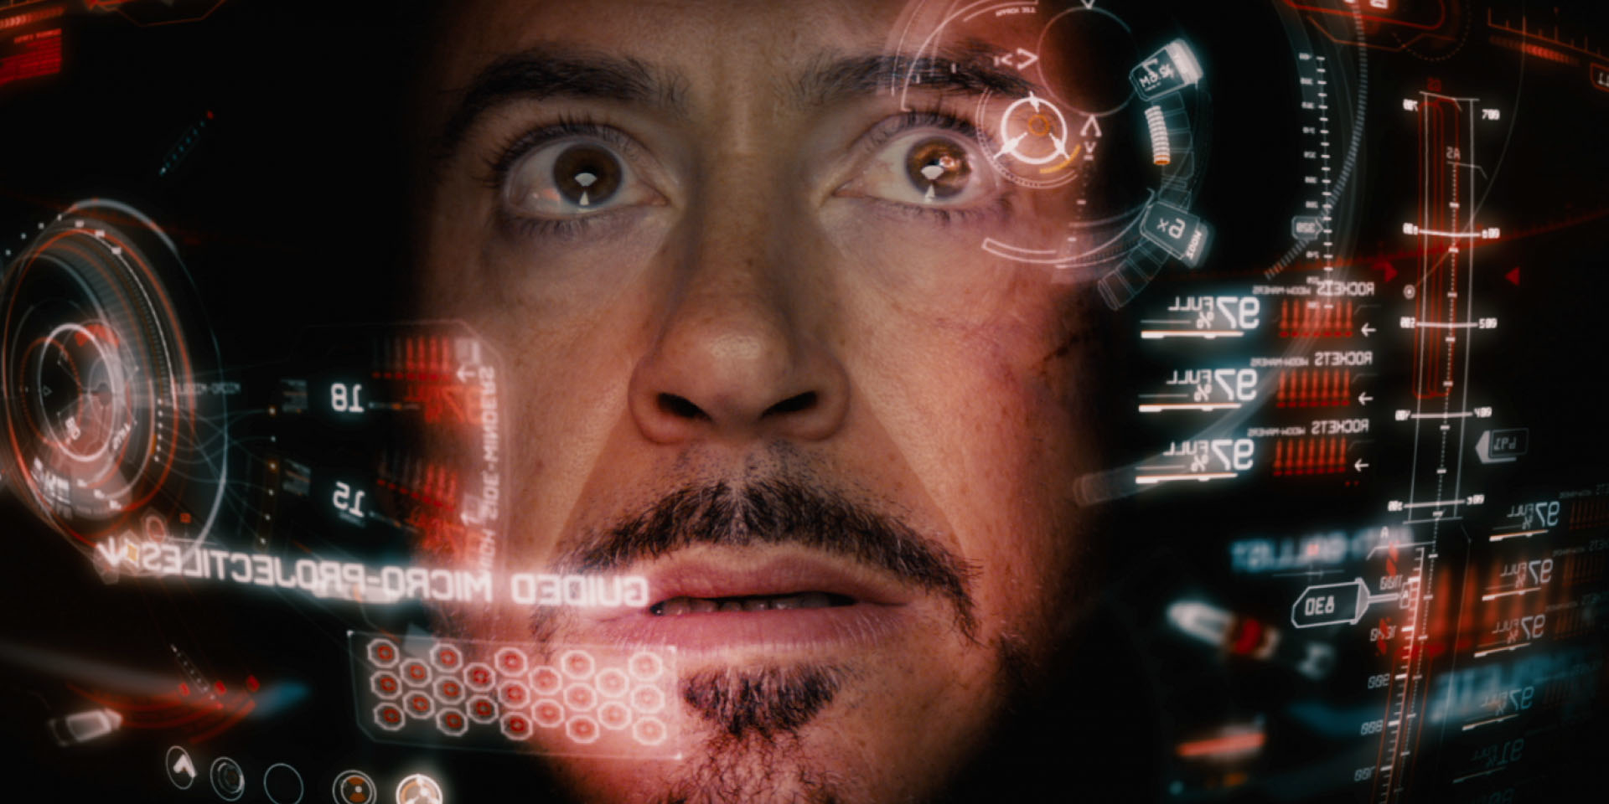
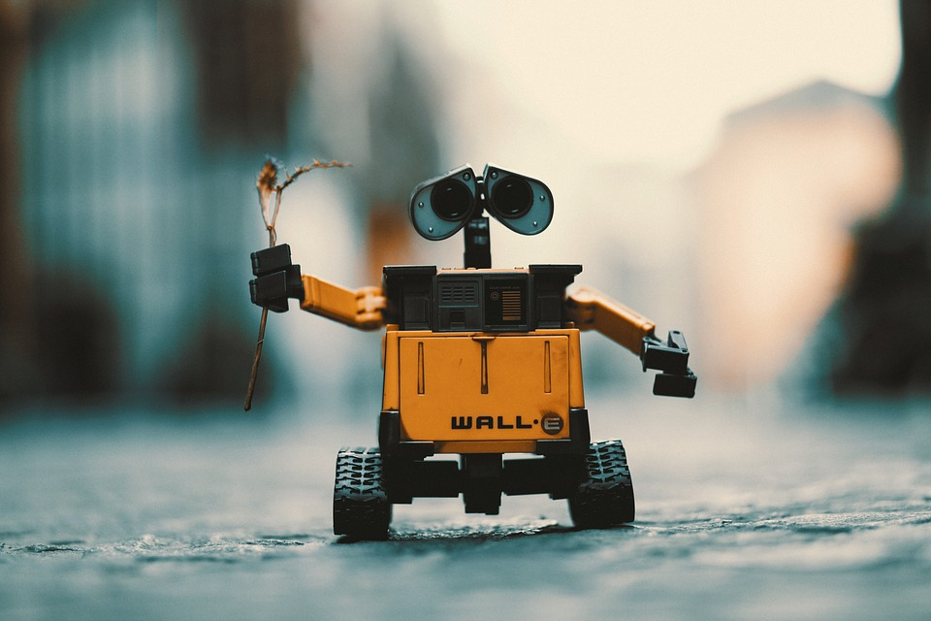
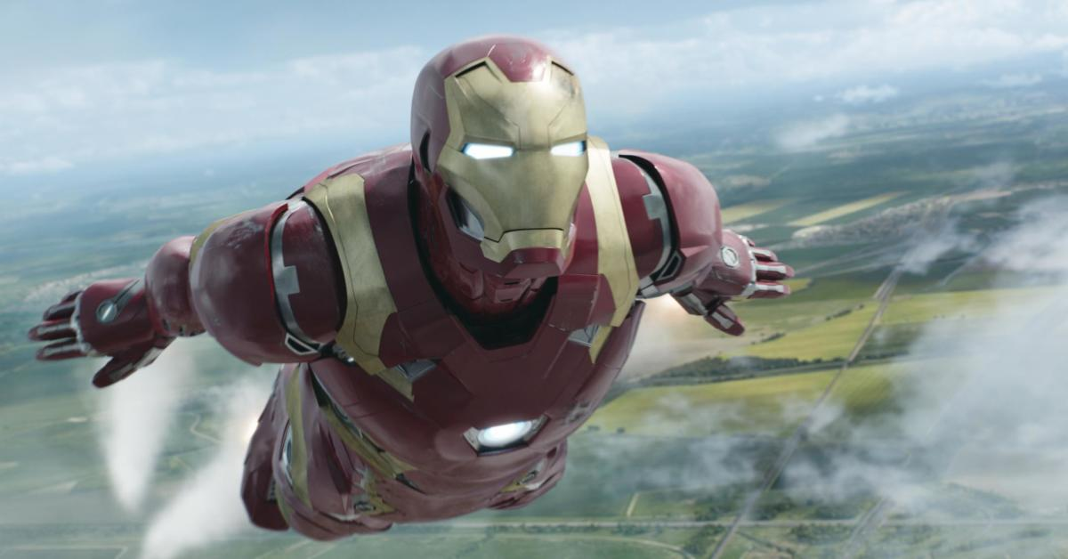
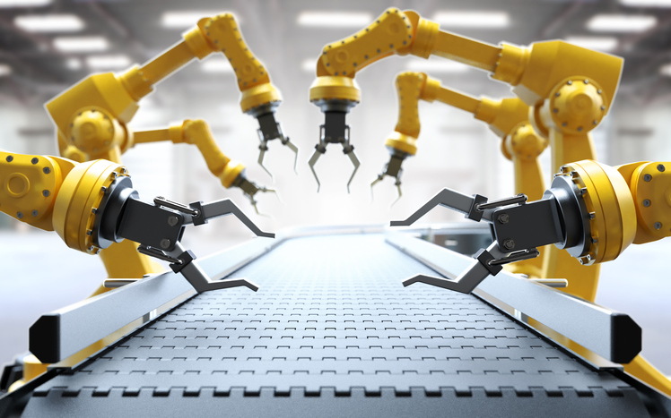
Robotics & Personal Assistants
Notes:
https://www.youtube.com/watch?v=QdQL11uWWcI

Slide 22
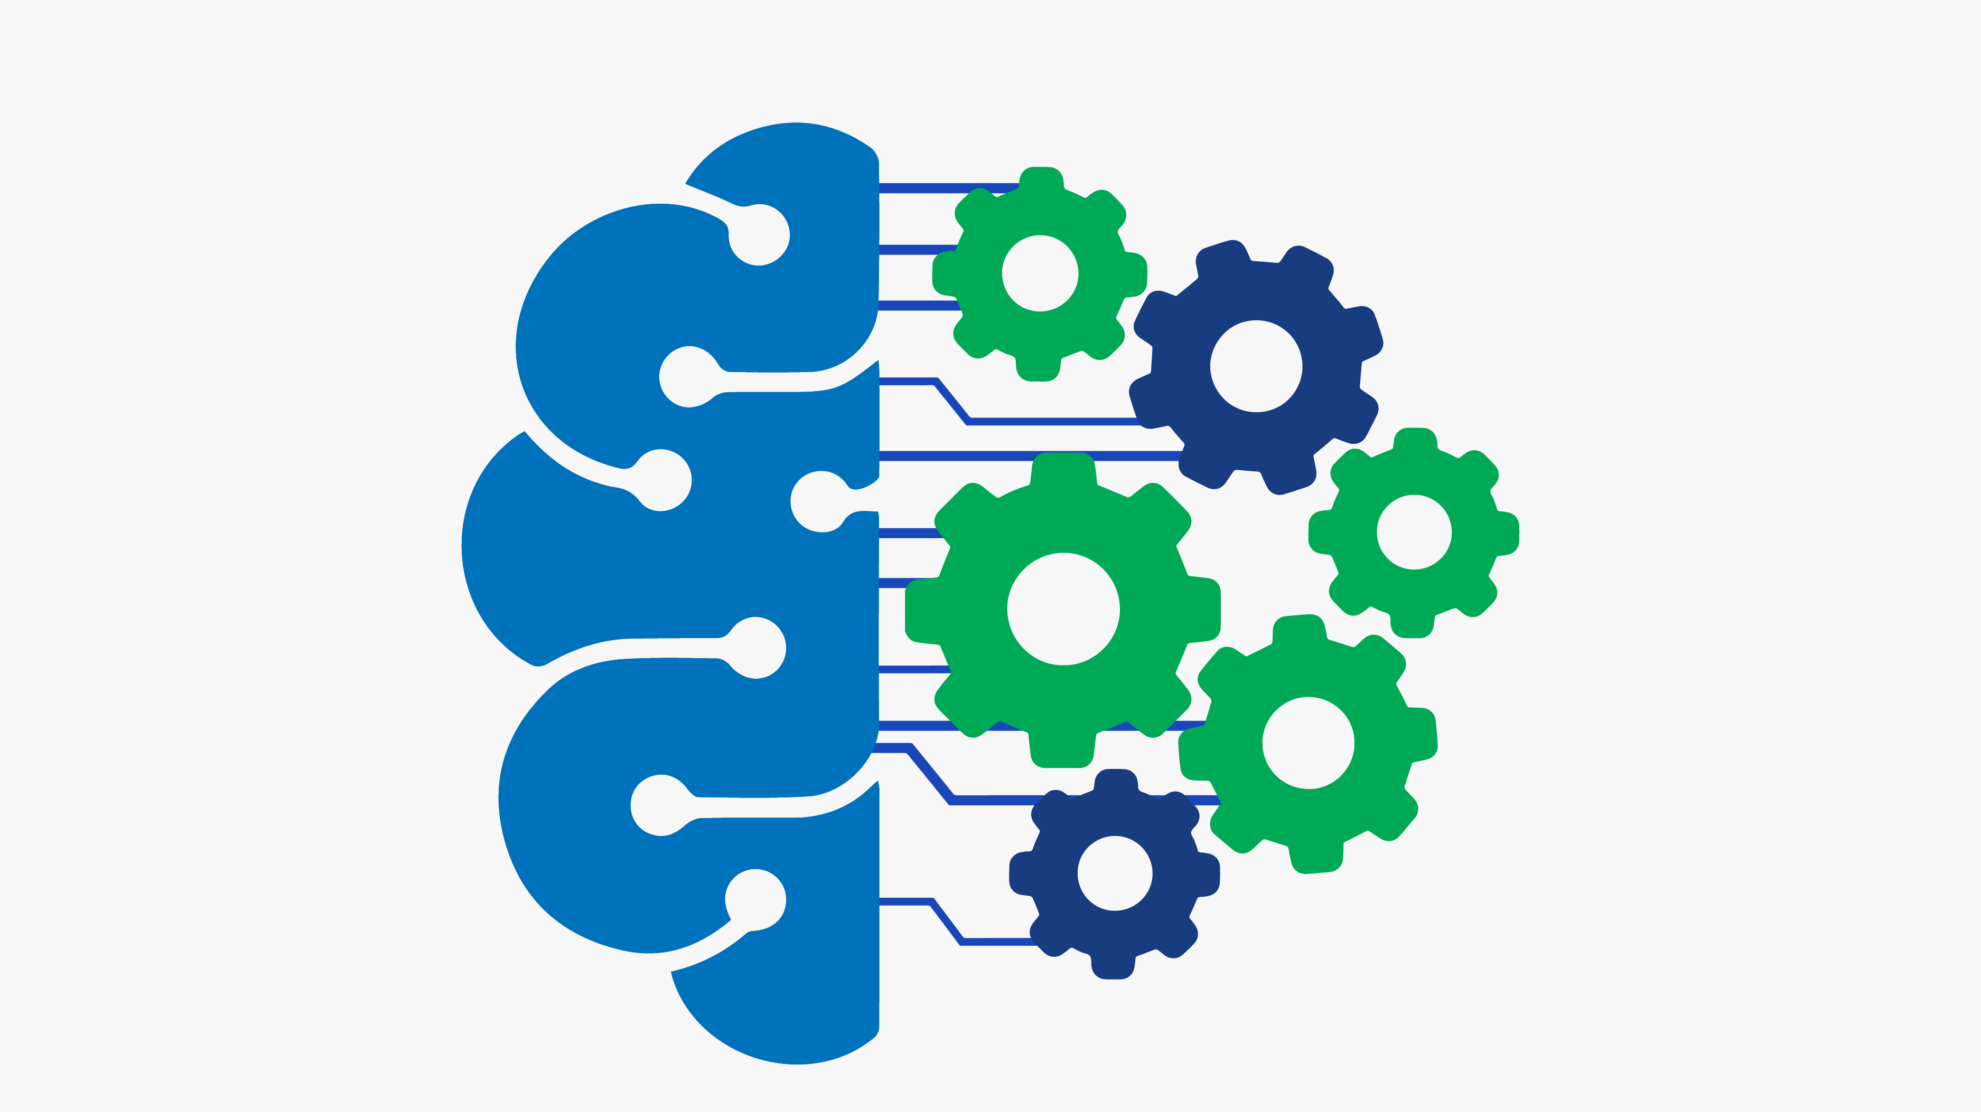
How to start in Machine Learning

Slide 23
Prerequisites
Linear Algebra
Statistics and Probability
Calculus
Programming Language

Slide 24
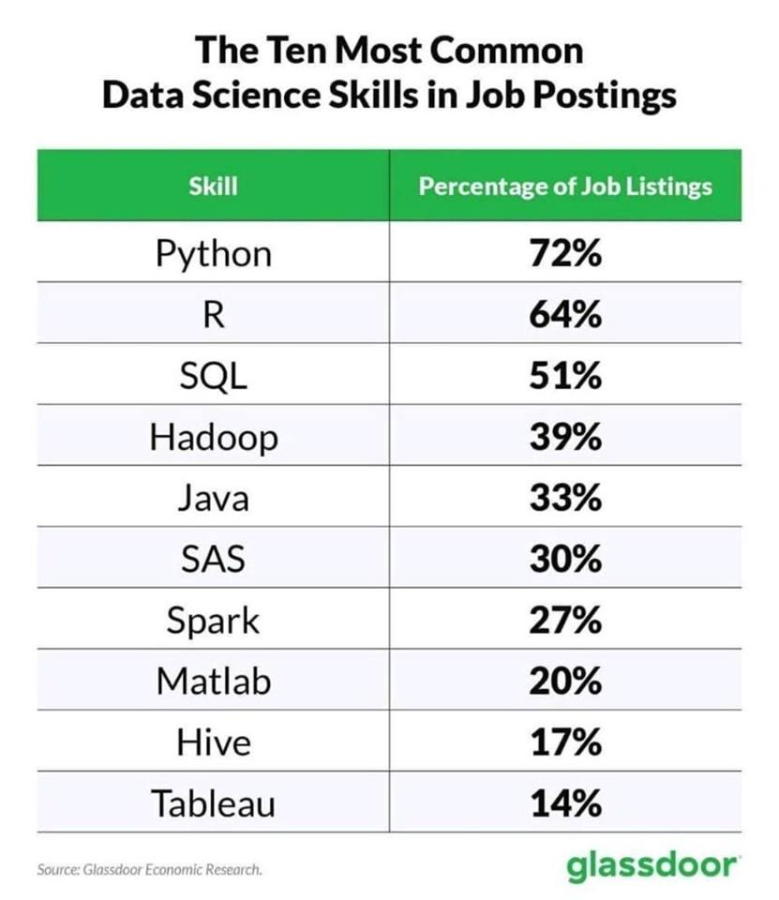
Programming Languages

Slide 25
Algorithms
Supervised Learning
Decision Tree
Unsupervised Learning
K-Means
Random Forest
Naïve Bayes
Logistic Regression
Linear Regression
Support Vector Machine
KNN Classifier
DBSCAN
OPTICS

Slide 26
Frameworks
Tensor Flow
Scikit Learn
Spark ML
Azure ML Studio
Amazon ML
Gensim
Theano
Torch

Slide 27


Thanks
Sayed A. Omar
https://www.linkedin.com/in/sayedomar
http://facebook.com/sayed931
devsayed1@gmail.com

